Slide 1

Name of the School: School of Computer Science and Engineering
Course Code: E2UC201C Course Name: OOPS
PROJECT TITLE-BANK ACCOUNT MANAGEMENT SYSTEM
Team Details:
Section-05
Project ID-1619
Name-Rishabh raj(23SCSE1011979)
Name- Hemant kumar(23SCSE1011458)

Slide 2
Name of the School: School of Computer Science and Engineering
Course Code: E2UC201C Course Name: OOPS
Project Title : Bank Account Management system
Subtitle: Object-Oriented Programming Concepts Applied to Financial Management

Slide 3
Name of the School: School of Computer Science and Engineering
Course Code: E2UC201C Course Name: OOPS
outline
Project title
Introduction
Overview
Flowchart
Technology used
conclusion

Slide 4
Name of the School: School of Computer Science and Engineering
Course Code: E2UC201C Course Name: OOPS
OVERVIEW
.
Effective management of bank accounts is crucial for individuals and businesses to maintain financial stability and plan for the future. In this presentation, we'll explore how Python and object-oriented programming can be leveraged to build a robust bank account management system.

Slide 5
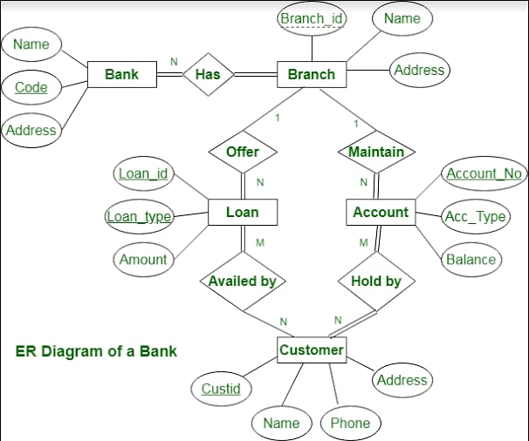
Name of the School: School of Computer Science and Engineering
Course Code: E2UC201C Course Name: OOPS
Flowchart

Slide 6
Name of the School: School of Computer Science and Engineering
Course Code: E2UC201C Course Name: OOPS
Technology Used
• Interpreter Used:
vs code;
• Libraries used:
built in modules:
1.random
2.datetime

Slide 7
Name of the School: School of Computer Science and Engineering
Course Code: E2UC201C Course Name: OOPS
Conclusion
The conclusion of a bank account management system is to handle the account
data of Customers ,as like their loan ,amount availability,interest etc.

Slide 8
THANK
YOU

